Slide 1
North America Energy Production vs. $$$ Strength
Project 1
Team: Kelvin Deng, Thao Hoang, May Ang, Yijing Su
Date: Nov 12, 2020

Slide 2
Agenda
Topic motivation
Work process (data exploration, transformation, and analysis)
Findings and implications
Next steps

Slide 3

Motivation
Energy and the Economics
Oil Exports and Dollar Strengths
Future of Renewable Energy and Dollar Strengths

Slide 4

Motivation Background
Crude oil is the largest single contributor of Canada’s revenue from foreign exchanges.
The contribution of oil export volume to the economics (e.g. GDP).
CA production exported to US 2018:
Crude oil: 84% (48% of total US imports)
Notes:
CA: ranked 4th in Crude Oil production and export
US:
https://www.investopedia.com/articles/investing/021315/how-why-oil-impacts-canadian-dollar-cad.asp
Source; Energy Fact Book 2019-2020

Slide 5
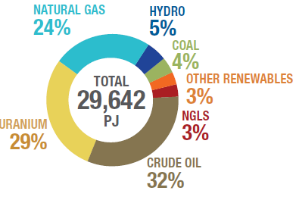
Motivation Background
CA primary energy production 2017:
Crude oil 32%
Hydro and Other renewable: 8%
Despite the large oil reserve in Canada, the world is shifting towards using clean and renewable energy in the near future.
How would lower crude oil demand affect Canadian economics and CAD?

Slide 6

Questions of Interest
1/ Historical correlations between:
Crude exports vs. Dollars
Crude GDP contribution vs. Dollars
2/ Forecast of $$$ strength in the ever evolving energy industry?
Renewable energy production and projection into future
Renewable energy production vs. Dollars

Slide 7
Data Exploration
Data 1 Crude Export
EIA – US Energy Information Administration
STATCAN – Statistics Canada
Crude Export vs. Dollars
Crude GDP contribution vs. Dollars
Data 2 Dollar Strength
Trading Economics.com
Exchange Rate API (open source)
Data 3 Renewable Energy
Energy production from renewable sources
Renewable energy vs Dollars
BEA – Bureau of Economic Analysis
CER – Canadian Energy Regulator

Slide 8
Data Transformation Challenges
Limited data on energy production
Bad quality data (NaN rows, random spaces, duplicated titles)
Incomplete data sets with empty rows
Structural conflicts (rows vs. columns)
Something new we learned during the process:
Datetime Library

Slide 9
Data Analysis Process
1. Brainstorm expected results (Planning)
2. Raw data cleaning (Extraction)
3. Merge and analyze (Transformation)
4. Plotting and draw conclusions
(Plotting)
Python on Jupyter Notebook
& GitHub Branches

Slide 10
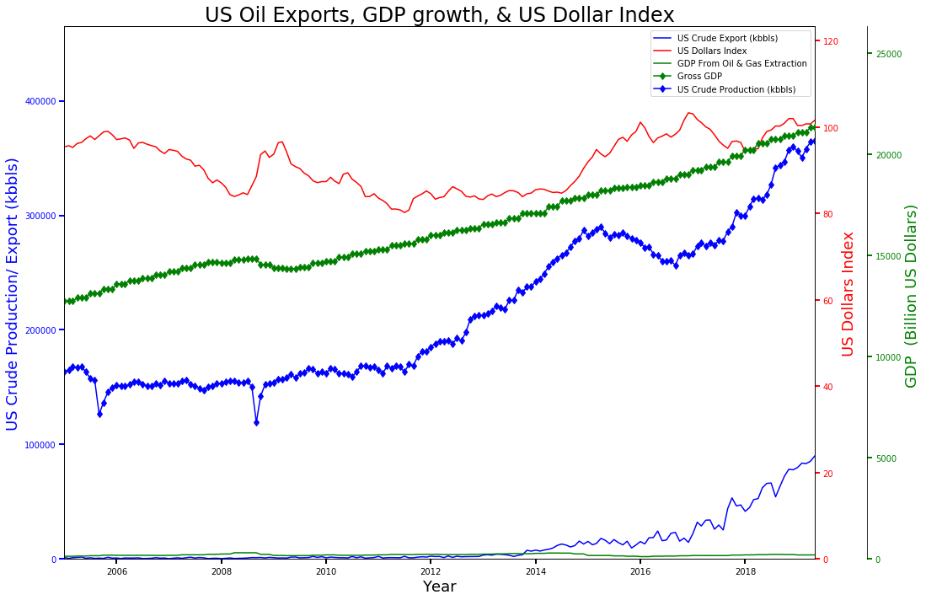
Findings
- US was not a crude exporter until recent years (2014+)
- GDP contribution from O&G sharply decreases after 2014 but Gross GDP still increases steadily, even though Oil Export spikes up after 2014
Conclusion:
- US economics and USD strength does not heavily rely on Oil Production and Export

Slide 11
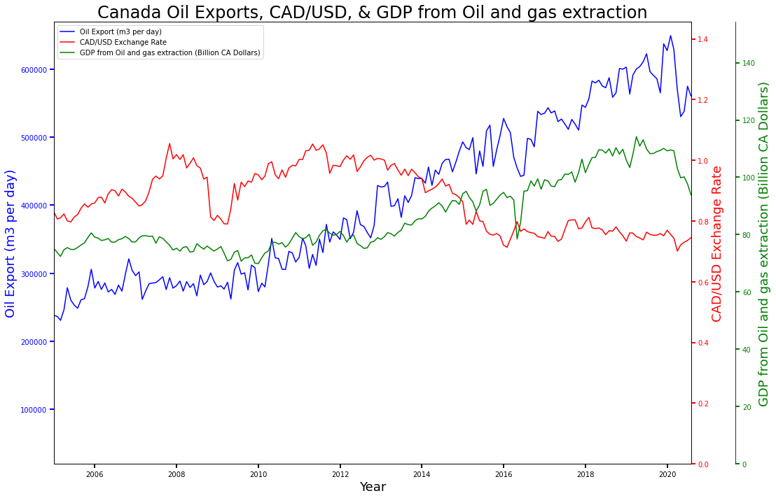
Findings and Plots
CA Crude Export vs. Economy
Crude export from CA ↑ in the past 15 years
No direct correlation with CAD/ USD exchange rate
GDP from Crude Export have similar trend with Crude export

Slide 12
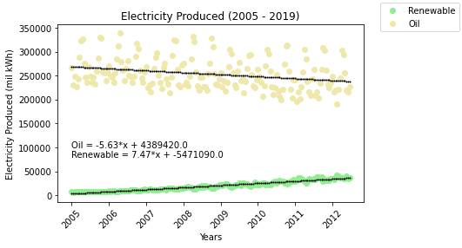
Findings
US Electricity vs. Economy
Electricity from fuels decreases by X%
Electricity from renewable energy sources increases by X% (expected 70% +)
No direct correlation with US Dollars Index

Slide 13
Findings (Su’s)
US Electricity vs. Economy
Electricity from fuels decreases by X%
Electricity from renewable energy sources increases by X% (expected 70% +)
No direct correlation with US Dollars Index

Slide 14
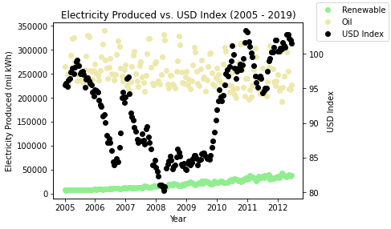
Findings
US Electricity vs. Economy
Electricity from fuels decreases by X%
Electricity from renewable energy sources increases by X% (expected 70% +)
No direct correlation with US Dollars Index

Slide 15
Limitations of Analysis
Disregarded other factors affecting the economics
First date of the month was representative of the entire month

Slide 16
Next steps
Discuss any additional questions that came up, but which you didn't have time to answer: What would you research next, if you had two more weeks?

Slide 17
References
http:…

Slide 18

Thank you for listening

Slide 19

Motivation Background
CAD/USD Exchange Rate:
Exchange rate is strongly correlated to crude oil price
Oil price ↑ = CAD ↑
Exchange rate is dependant on supply/ demand of both currencies
CAD supply ↓ / CAD demand ↑ = CAD ↑
Crude oil price is determined by crude supply/ demand
Crude supply ↓ = Oil Price ↑
Notes:
CA: ranked 4th in Crude Oil production and export
US:
When crude oil price is high, the amount of USD earned by Canada from oil export is high, thus supply of USD flowing into CA is high relative to supply of CAD, thus increase CAD dolllars strength
https://www.investopedia.com/articles/investing/021315/how-why-oil-impacts-canadian-dollar-cad.asp

Slide 20
Findings Implications
Canadian Dollars is impacted by Crude Oil Production/ Exports
Crude Oil contribution to Gross GDP is X% (2.8%)
US Dollars is not impacted by Crude Oil Production/ Exports
Crude Oil contribution to Gross GDP is ~1%
US electricity production from renewable sources is projected to catch up to oil sources in 2061

